Slide 1
ADVANCED VEHICLE BLACKBOX
Jose Garza, Prisha Srivastava, Lide Su, Christian Loth

Slide 2
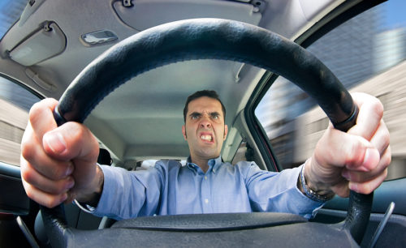
Problem Background
Chances of collision increase as drivers perform unsafe maneuvers.
Drivers are unaware of their driving behaviours.
Insurance companies charge for insurance based on assumptions of age and car model. Creates unfair systems.
Accidents are preventable.

Slide 3
Goals and Objectives
Encourage healthy and responsible driving practices through automated, real-time monitoring systems.
Create an accurate profile such that it increases self-awareness.
Realistically grasp a driver’s current driving behavior and through consistent monitoring, reduce their chances of collisions or accidents.

Slide 4



vBox Features
Incorporates a custom algorithm that detects safe and unsafe driving practices.
Effectively and constantly gathers data from its sensors.
Collects real-time data to consistently monitor and improve behaviors with realistic approach.

Slide 5
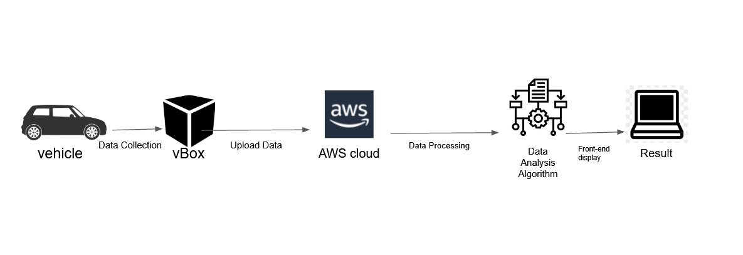
High Level Block Design

Slide 6
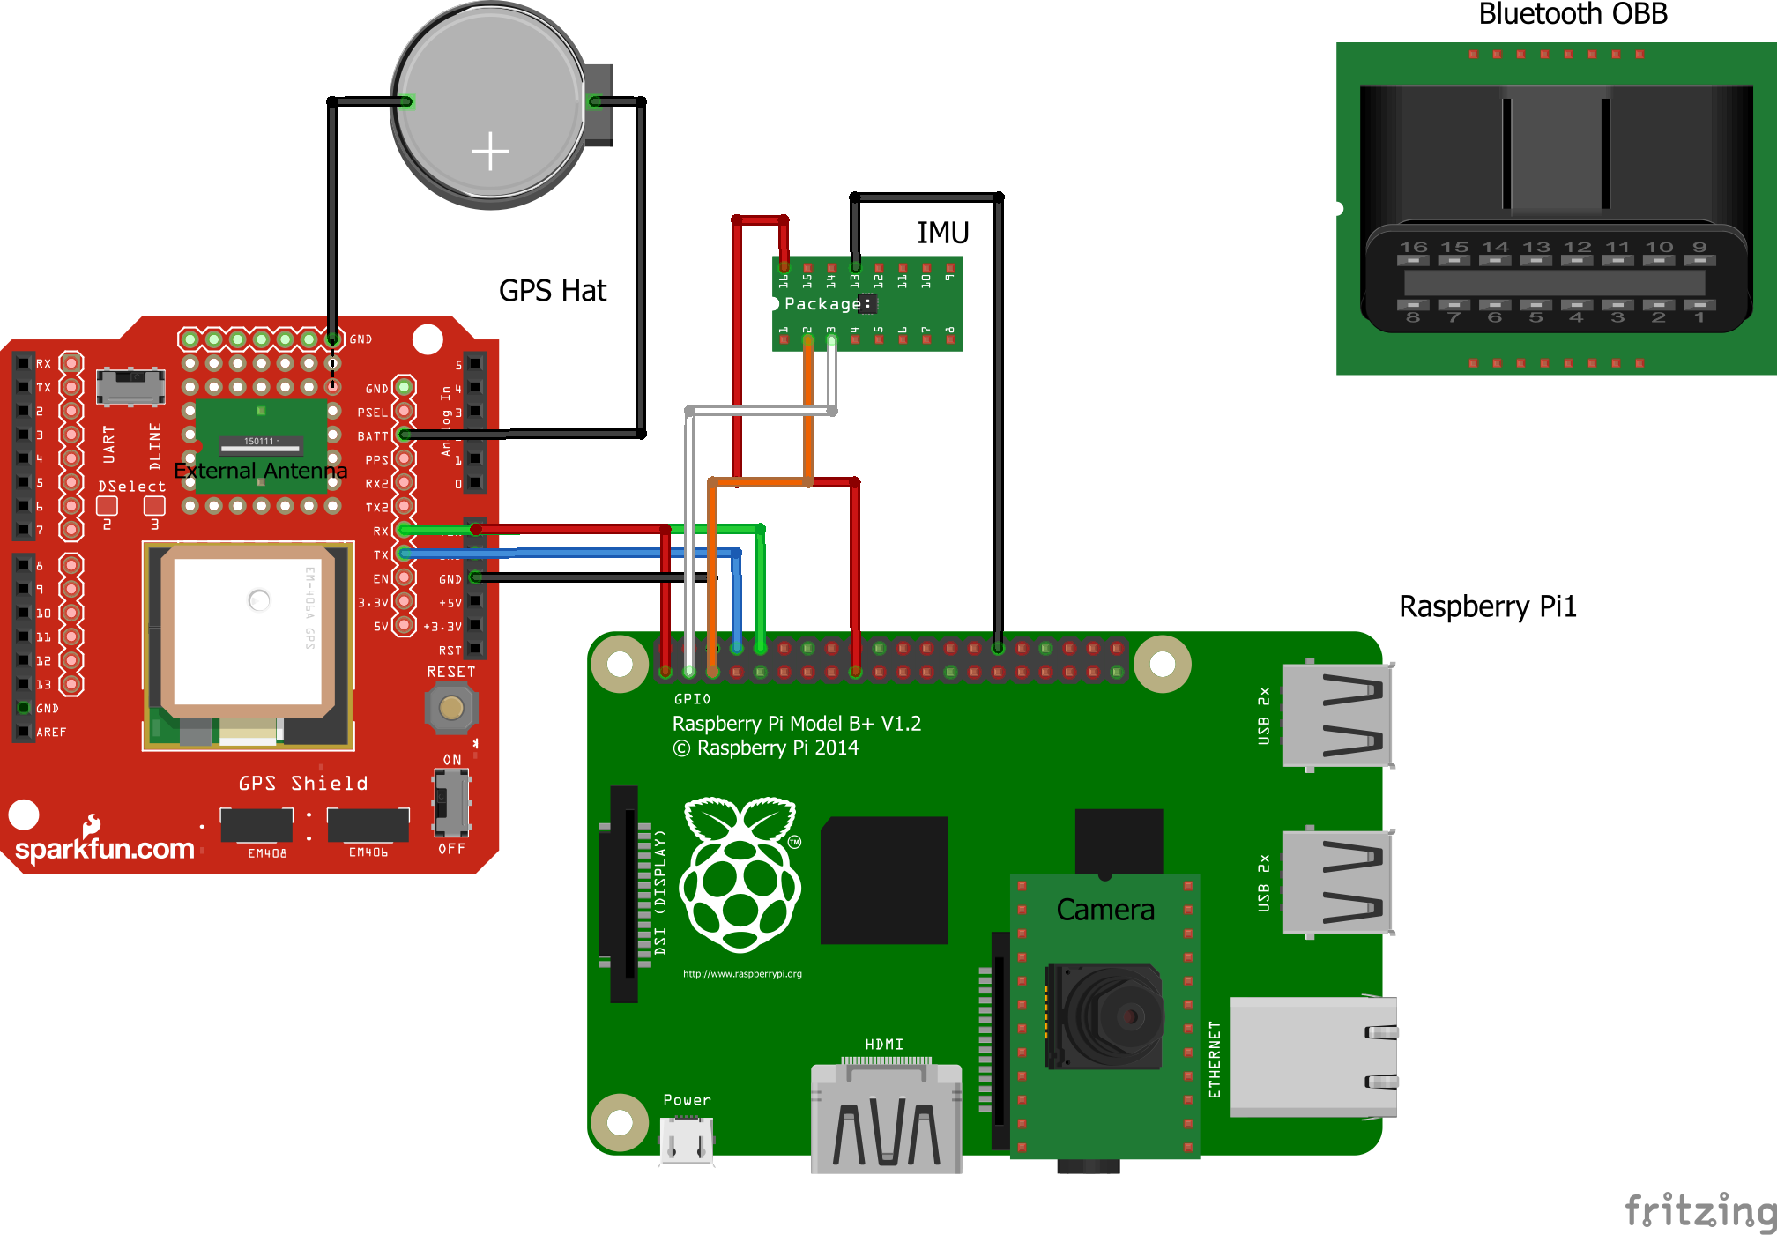
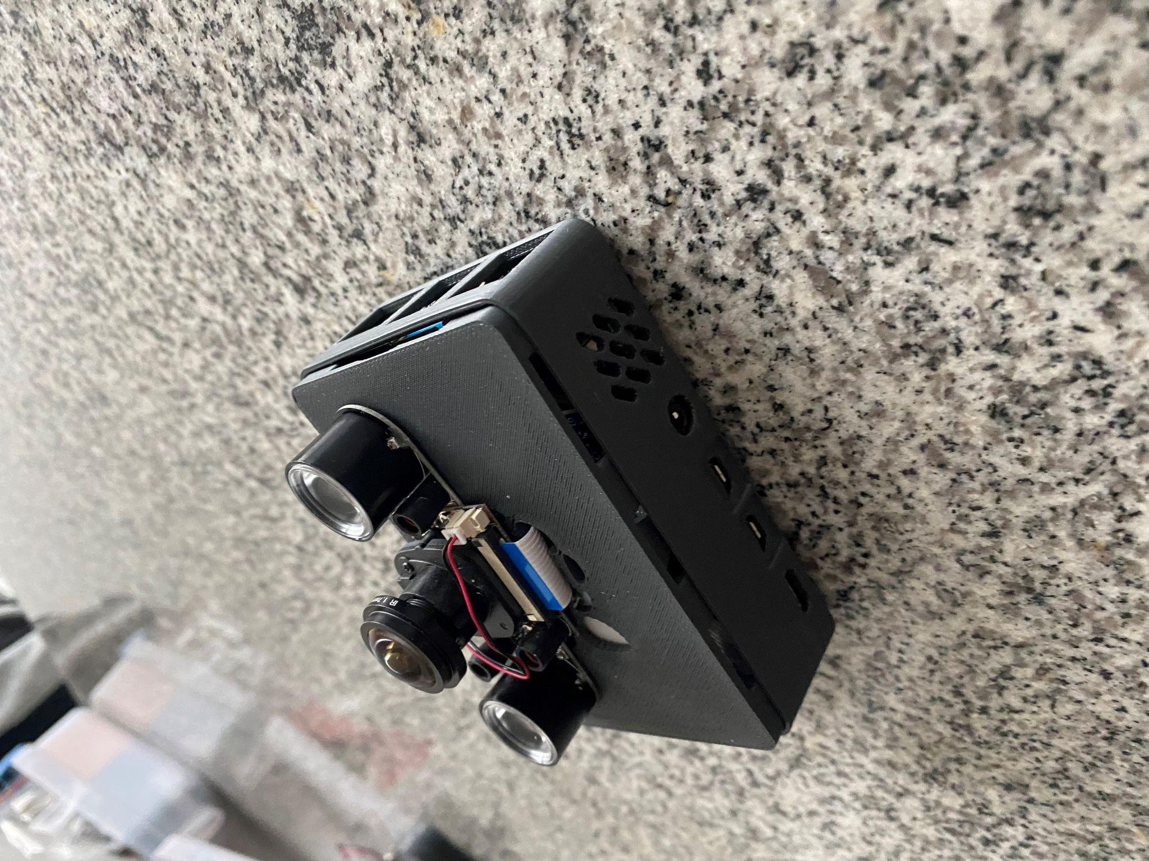
Sensor Connections

Slide 7
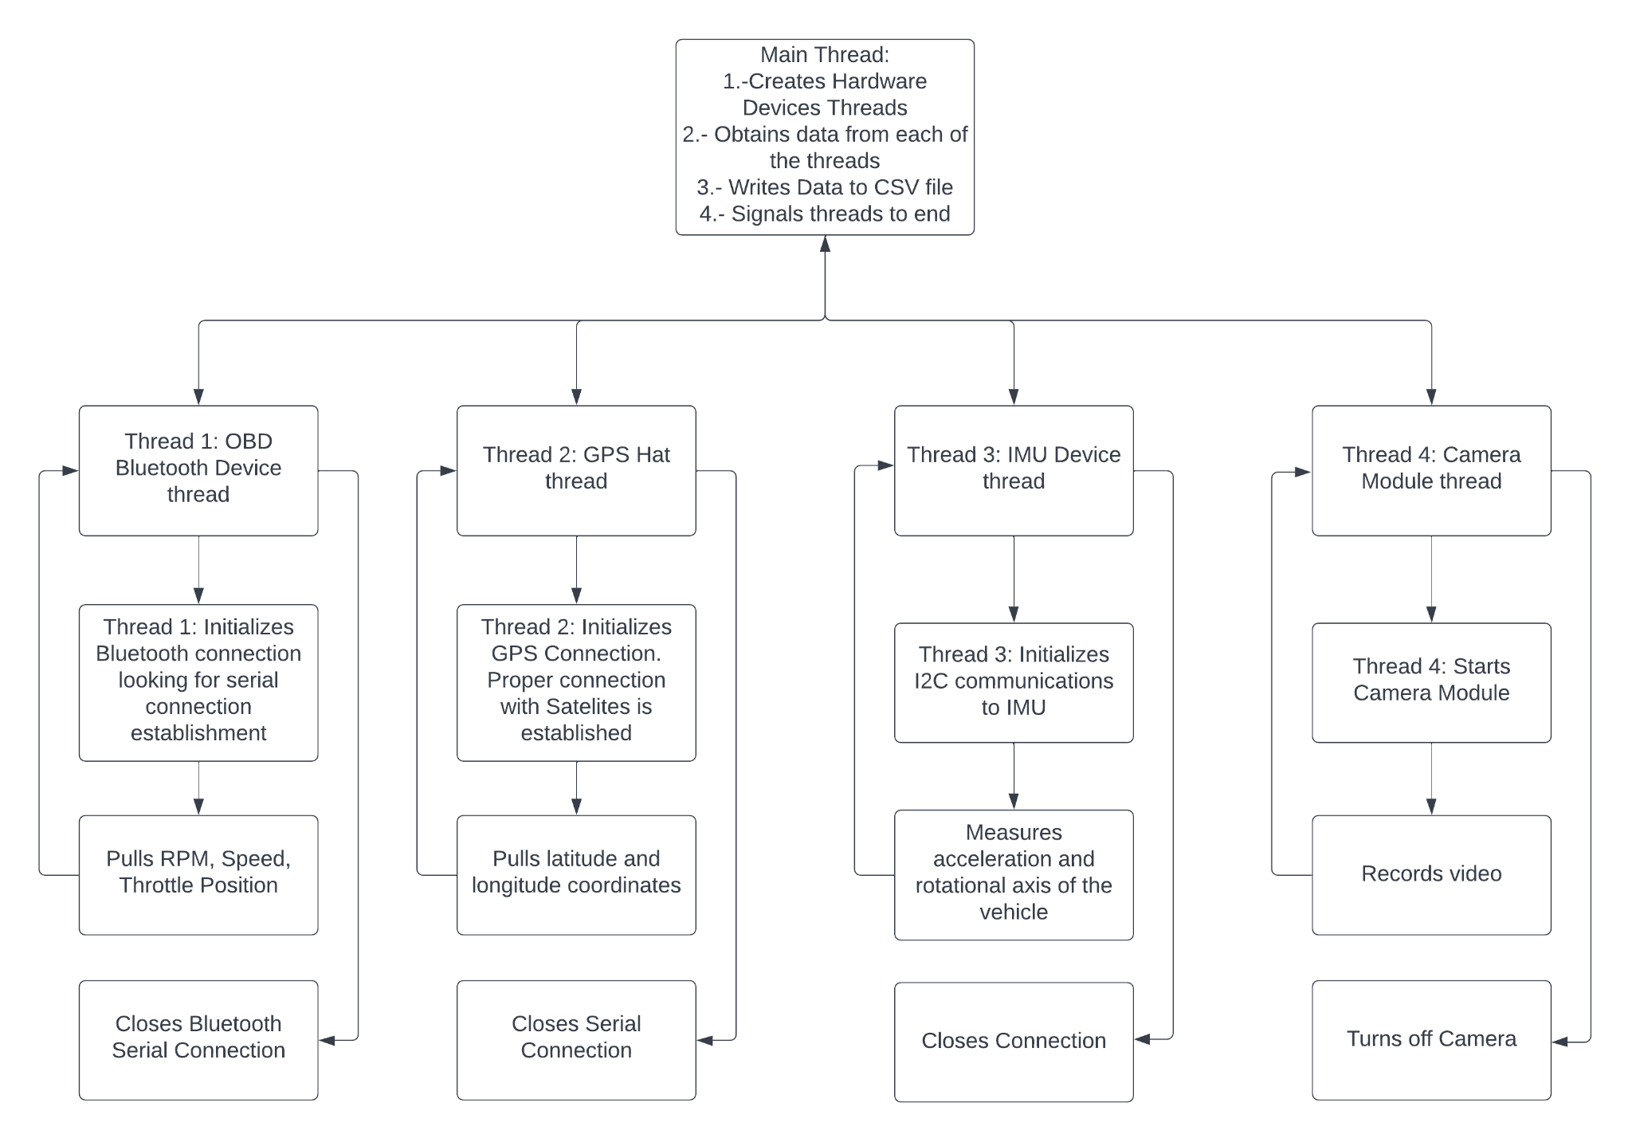
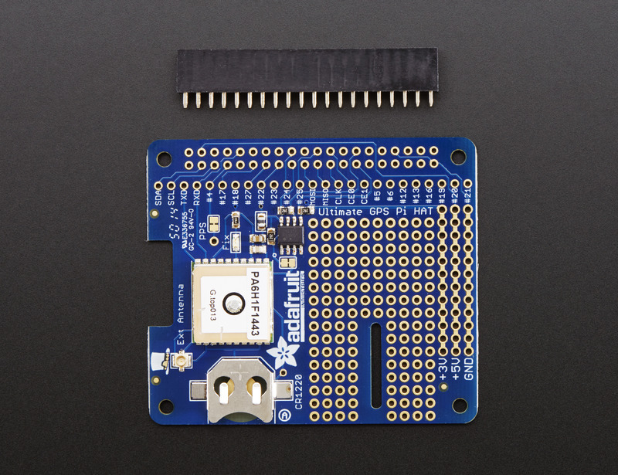
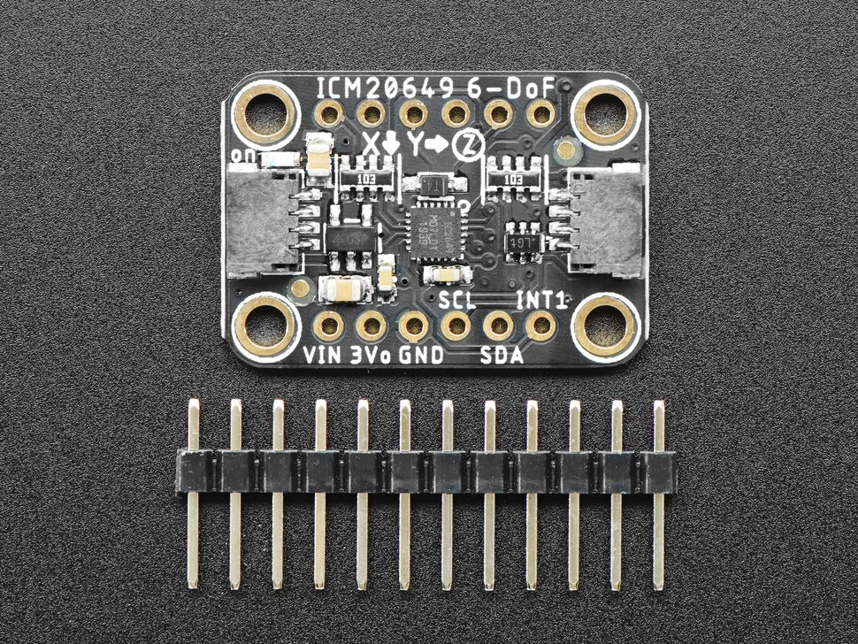
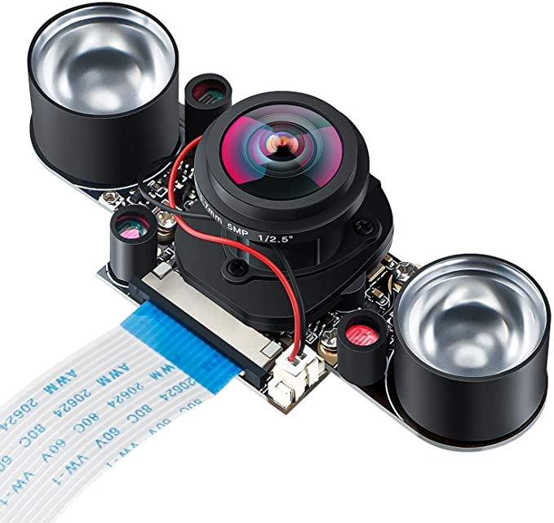
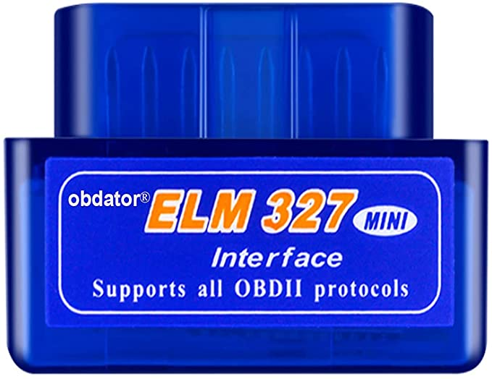
Software Sensor Data Retrieval

Slide 8
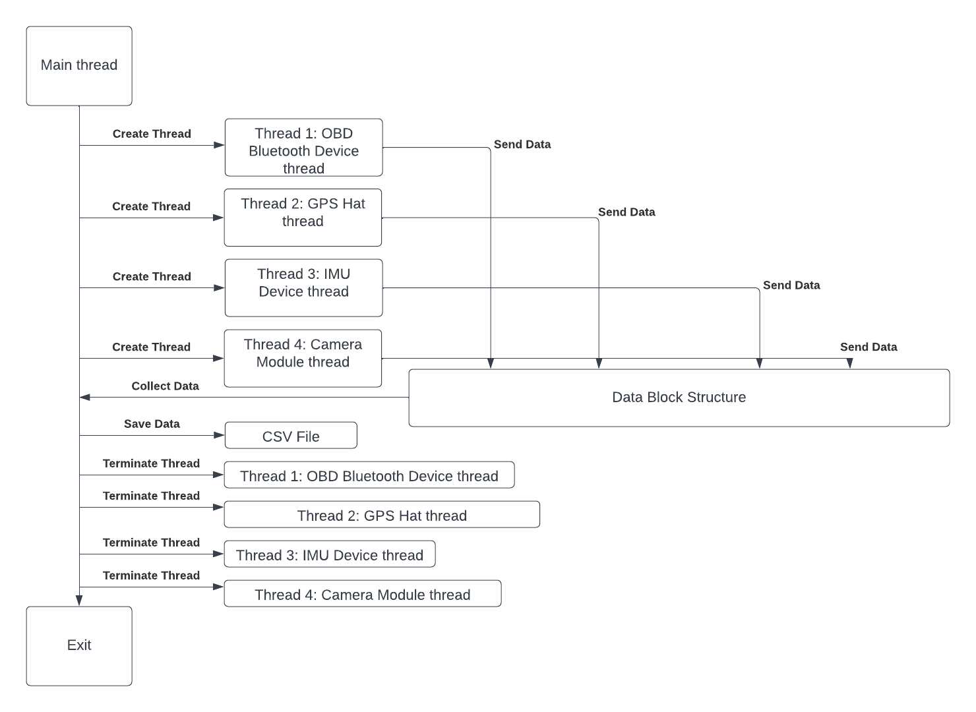
Software Sensor Data Retrieval

Slide 9
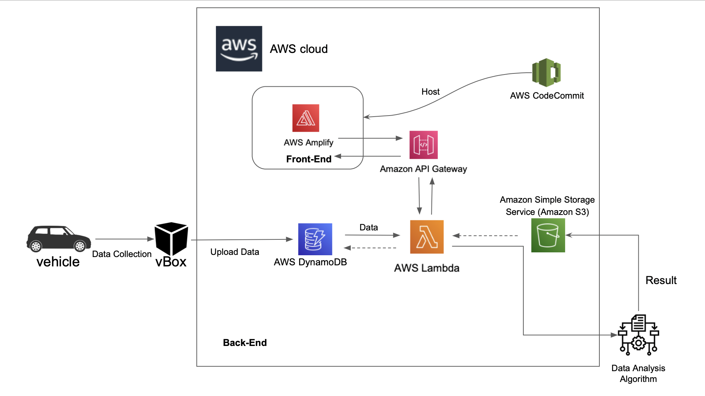
Embedded System

Slide 10
Evaluation of alternative solutions
USB OBD
Would require another cable running from the OBD port which is located under the steering wheel to the Raspberry Pi in the windshield.
Standalone GPS (no external antenna)
Would not provide accurate GPS readings.
In some cases takes too long to calibrate.
Standard IMU
Lacks insight from road conditions (i.e bumpy, traffic giving inconsistent speed reading)
GPS based Web Platform
Location tracking and speed detection through GPS may lack context in situations where driving above or below the speed limit is realistic.
Speed is not as accurate as the speed of the car ECU.
Real Time Data Upload
Would increase complexity and costs by adding another module.

Slide 11
Approach for design validation
Our design is intended to transition from prototype to final deployment through a series of layered testing that allows us to thoroughly examine the functionality of hardware and software aspects of our project.
Embedded Hardware System
Run simple python scripts on Raspi terminal to generate terminal output of sensor readings
Use multimeter to check soldering connection.
Web App Software Testing
Local testing of web application to test if profile data exists and is valid.
Receives analysis output from backend script and presents on the application through visuals and real-time record.
Back-end Algorithm Testing
Required data is provided by retrieving data from database.
Using 6 testing scenarios (or “switch cases”), different in observed speed and road type, an algorithm identifies certain points and concludes anomalous driving behavior.

Slide 12
Economic Analysis
Description | Price | Quantity
Raspberry Pi 4 Camera | $24.59 | 1
Adafruit GPS Hat | $29.95 | 1
External GPS antenna | $19.95 | 1
IMU (Accelerometer & Gyro) | $14.95 | 1
Standoffs for Pi HATs | $0.75 | 1
RF Adapter cable | $3.95 | 1
Bluetooth interface OBD port | $13.99 | 1
Raspberry Pi 4 | $167.95 | 1
SD card with 256 GB | $29.99 | 1
Car charger for Raspberry Pi 4 | $14.44 | 1
Suction Cup Mount | $24.99 | 1
3D Printed Enclosure | $5.00 | 1
The parts originally ordered have been able to achieve the desired results.
Total = $345.50
Notes:
christian

Slide 13
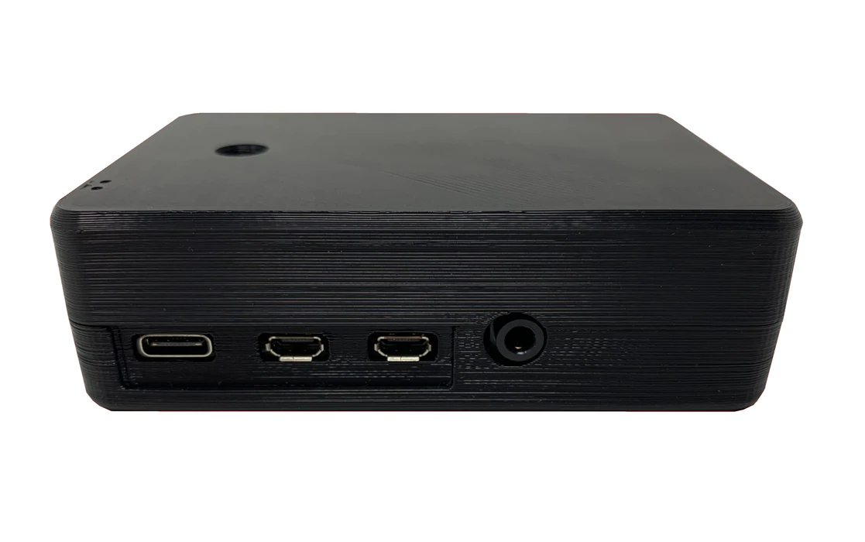
Manufacturability, Sustainability and Economics of vBox
Manufacturability:
Product will use SLA resin to create a thermoset case for the Raspberry Pi.
Sustainability:
3D printing produces more sustainable solutions than traditional manufacturing methods.
70-90% less scrap waste.
41-64% less energy consumed.
Economics of vBox:
Cost of Production: $345.50, RasPi 4 is 4.8 times more expensive than usual price.
Bulk Purchase of items would significantly reduce cost for larger-scale production.
Notes:
christian

Slide 14
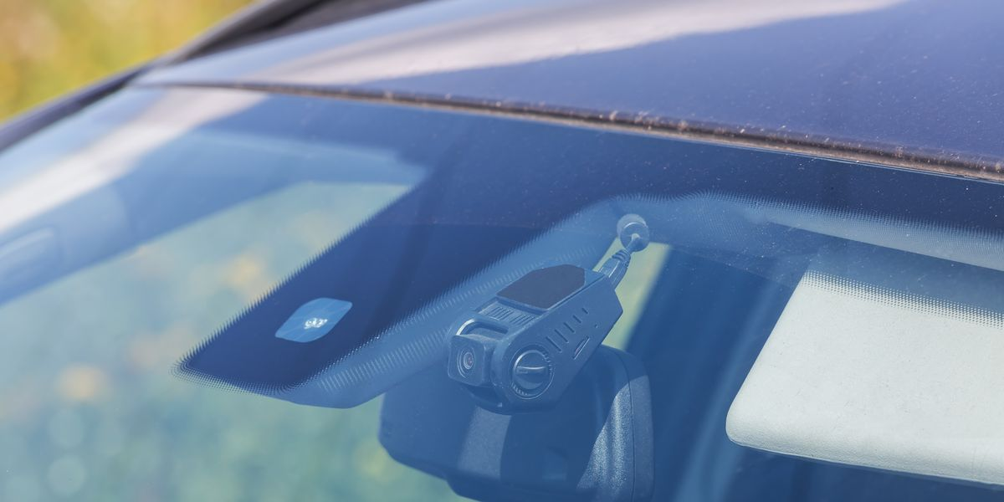
Health/Societal/Political/Environmental Concerns
Social
Society benefits directly from reduced poor driving practices -- more saved lives.
Environmental
Reducing the amount of crashed cars and car waste that pollutes the environment we live in.
Totaling cars is not good for the environment
Political
Road Safety continues to be a high-priority political topic.
Ethical
The more lives we save, the more ethical it is. We can save more lives by knowing the problem that caused a crash.
Notes:
christian

Slide 15
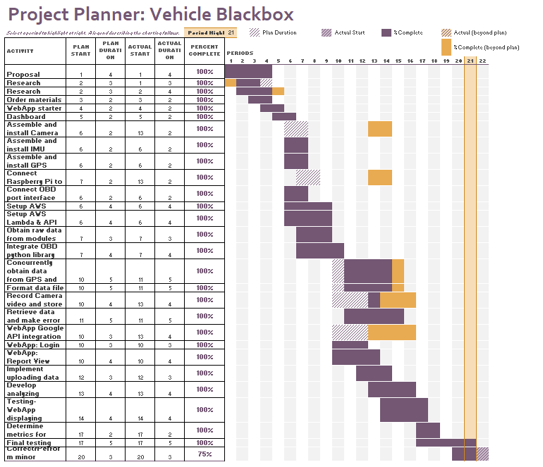
Schedule of tasks

Slide 16




Project Management and teamwork
Hardware
Software
Received the parts ordered and soldering the necessary parts.
Established a connection between each one of the components.
Integrated the module connections together for a more compact device.
Designed the case.
Data Analytics
Established AWS DynamoDB.
Implemented Lambda functions and API gateway.
Established connection from React app to AWS Amplify to host web app online.
Designed the dashboard that the users see of the WebApp.
Added different graphs and different attributes to the webpage.

Slide 17
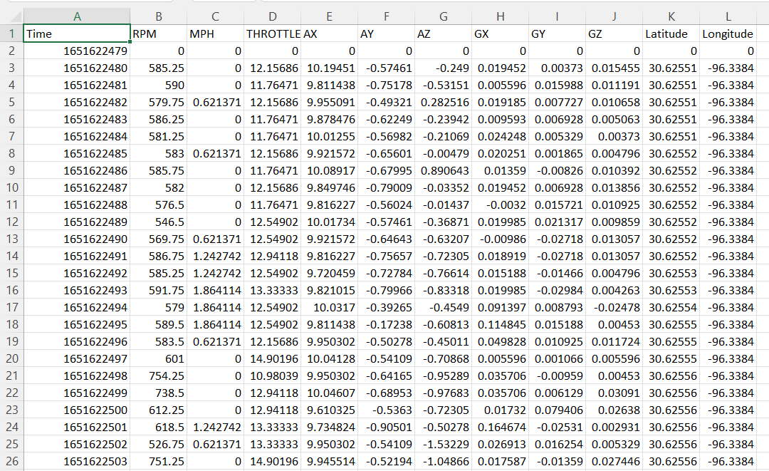
Raspberry Pi

Slide 18
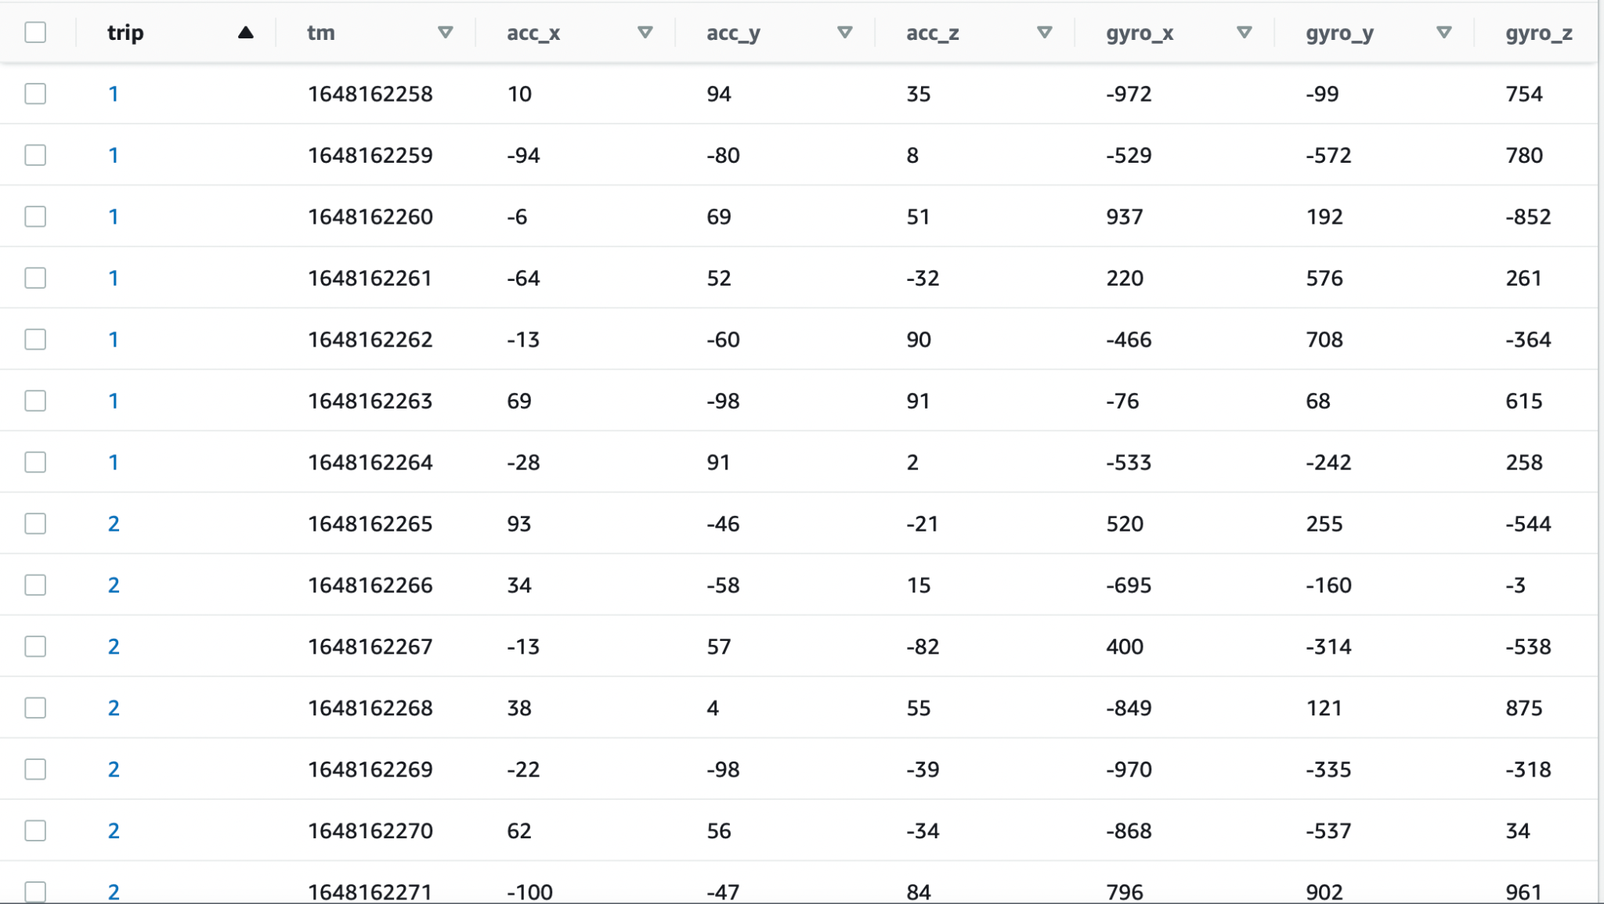
Back-End Demonstration
DynamoDB

Slide 19
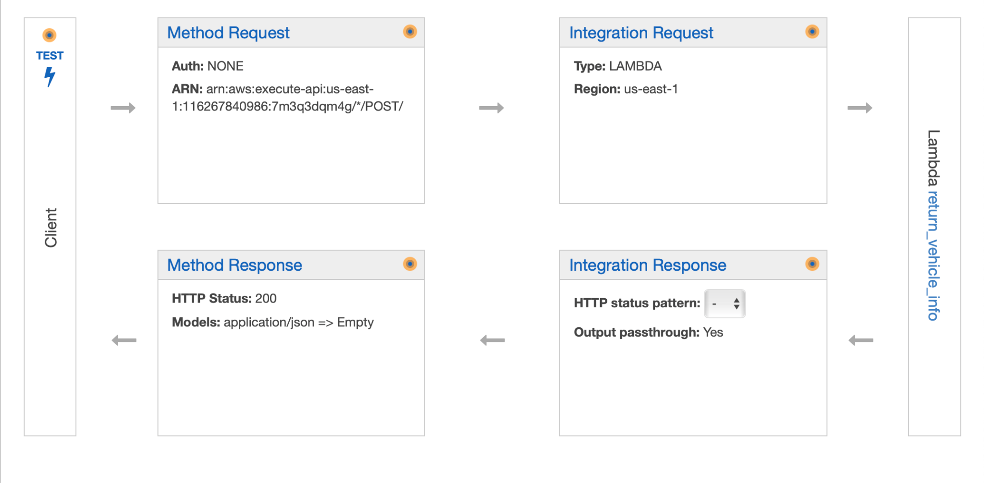
Back-End Demonstration-cont’d
API Gateway and Lambda function

Slide 20
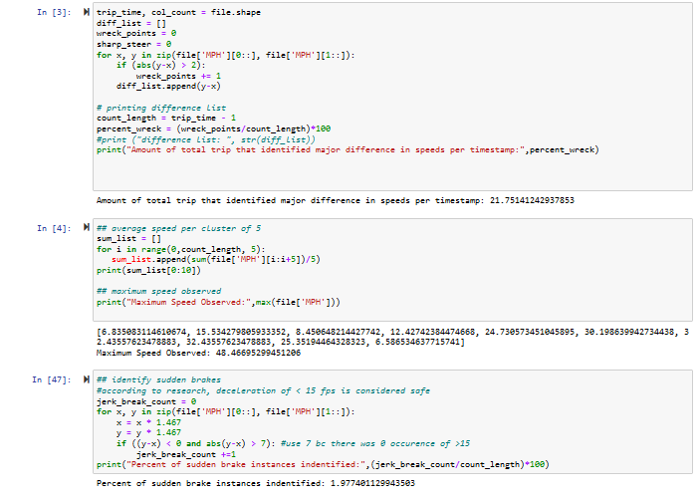
Drive Score Algorithm Script
Using real drive results from trip num csv’s
Identified abnormally high/low acceleration, max speed observed per sets of 5 timestamps, and sudden brakes
Took inspiration from other research papers on reasonable thresholds for variance in recording

Slide 21
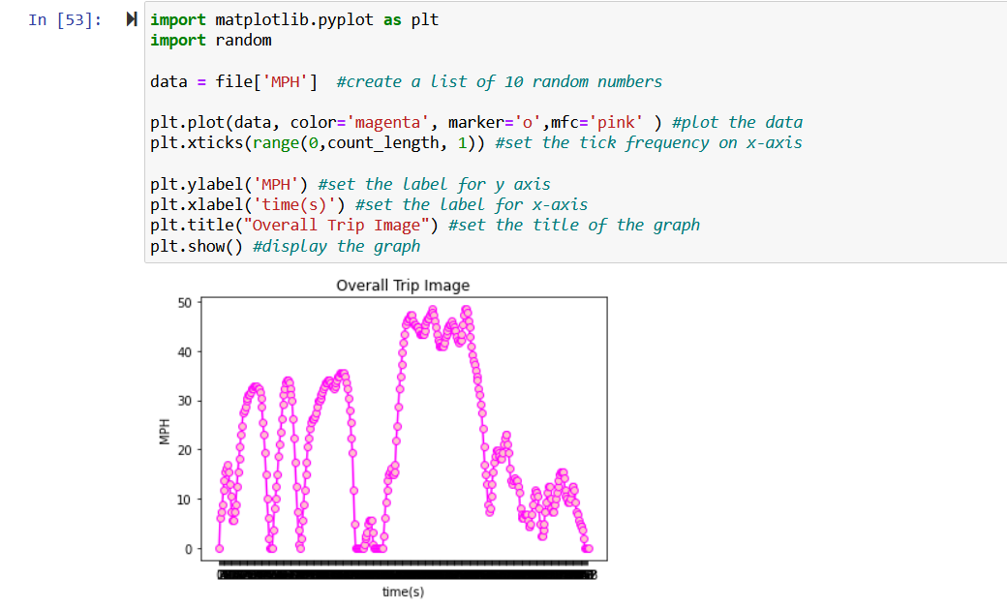
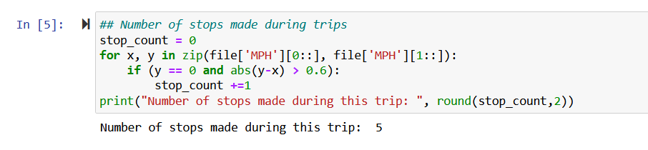
Driving Alg. Accuracy Model

Slide 22
We appreciate your attention
Questions?

